Slide 1

Scala Hierarchy

Slide 2
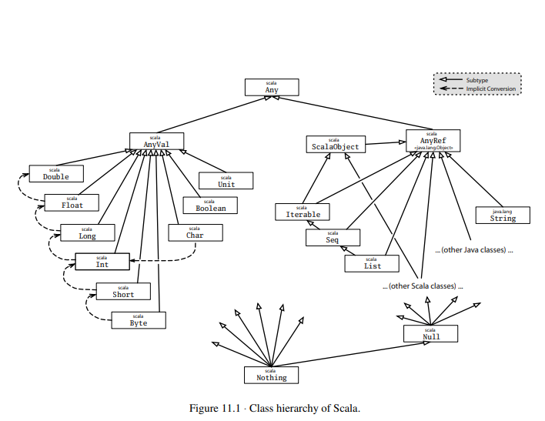

Slide 3
Scala’s class hierarchy
final def ==(that: Any): Boolean
final def !=(that: Any): Boolean
def equals(that: Any): Boolean
def hashCode: Int
def toString: String

Slide 4
AnyVal
Byte
Short
Char
Int
Long
Float
Double
Boolean
Unit

Slide 5
AnyRef
This is the base class of all reference classes in Scala is in fact just an alias for class java.lang.Object.
Scala classes are different from Java classes in that they also inherit from a special marker trait called ScalaObject. The idea is that the ScalaObject contains methods that the Scala compiler defines and implements in order to make execution of Scala programs more efficient. Right now, Scala object contains a single method, named $tag, which is used internally to speed up pattern matching.

Slide 6
How primitives are implemented
How is all this implemented? In fact, Scala stores integers in the same way as Java: as 32-bit words. This is important for efficiency on the JVM and also for interoperability with Java libraries. Standard operations like addition or multiplication are implemented as primitive operations. However, Scala uses the “backup” class java.lang.Integer whenever an integer needs to be seen as a (Java) object.

Slide 7
// This is Java
boolean isEqual(int x, int y) {
return x == y;
}
System.out.println(isEqual(421, 421));

Slide 8
// This is Java
boolean isEqual(integer x, integer y) {
return x == y;
}
System.out.println(isEqual(421, 421));

Slide 9
scala> def isEqual(x: Int, y: Int) = x == y
isEqual: (Int,Int)Boolean
scala> isEqual(421, 421)
res10: Boolean = true
scala> def isEqual(x: Any, y: Any) = x == y
isEqual: (Any,Any)Boolean
scala> isEqual(421, 421)
res11: Boolean = true

Slide 10
Bottom types
Null
Class Null is the type of the null reference; it is a subclass of every reference class (i.e., every class that itself inherits from AnyRef). Null is not compatible with value types.
Nothing
Type Nothing is at the very bottom of Scala’s class hierarchy; it is a subtype of every other type.

